Slide 1

OLYMPICS SPORTS
ANALYSIS

Slide 2


CONTENT
01
ABOUT OLYMPIC GAMES
02
OBJECTIVE
03
PROJECT TIMELINE
04
DOMAINS
05
SQL ANALYSIS
06
POWERBI ANALYSIS
07
KEY INSIGHTS
08
DATA SOURCE

Slide 3


ABOUT OLYMPICS SPORTS
The Olympic Games are the biggest and most prestigious sporting event, which brings together athletes from around the globe.
The first-ever Olympics were held in Athens, Greece in 1896. Since then, the Olympic Games are held every four years.

Slide 4
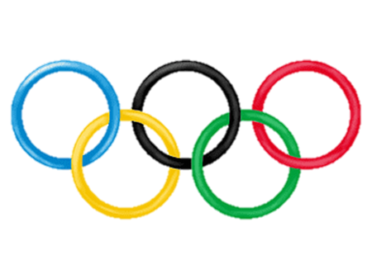

OBJECTIVE
The Olympic Games dataset provides a comprehensive representation of the event's nature, encompassing details about cities, events, games, medals, sports, participants,
and regions.
Task includes in-depth analysis across various dimensions, including :
the historical progression of games
the diversity of sports and events
the demographic profiles of participants
the geopolitical impact through regional representation and medal tallies.

Slide 5


PROJECT TIMELINE
01
02
03
04
ANALYSIS
DOMAINS
SQL ANALYSIS
POWER BI
ANALYSIS
KEY
INSIGHTS

Slide 6




DOMAINS
SEASON ANALYSIS
SPORTS ANALYSIS
PARTICIPANTS ANALYSIS
MEDALS ANALYSIS
Explore trends in game years and seasons. Analyze the distribution of games across different cities and regions. Investigate any patterns or changes in the number of events over the years.
Examine the popularity of sports over time. Identify emerging sports or sports that have been discontinued. Analyze the distribution of sports across different regions or countries.
Study the demographics of participants, including gender distribution, heights, and weights. Explore the age distribution of participants over the years. Identify regions with the highest number of participants.
Investigate trends in medal distribution over time. Analyze the distribution of medals across different sports and events. Identify countries or regions with the highest number of medals.

Slide 7
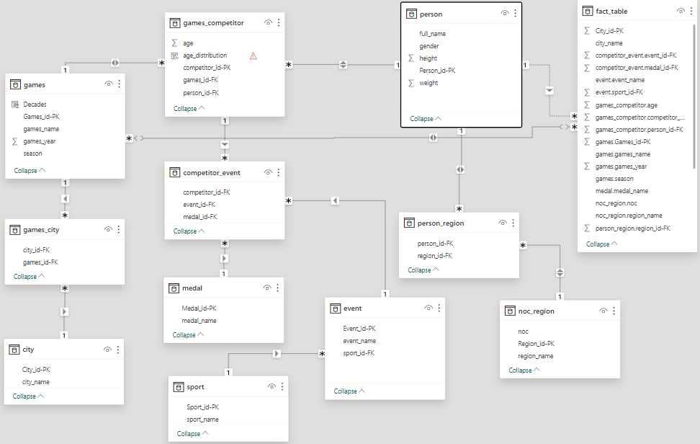
ER DIAGRAM

Slide 8

SQL ANALYSIS

Slide 9
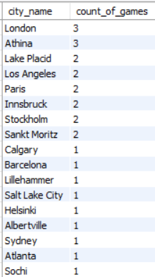
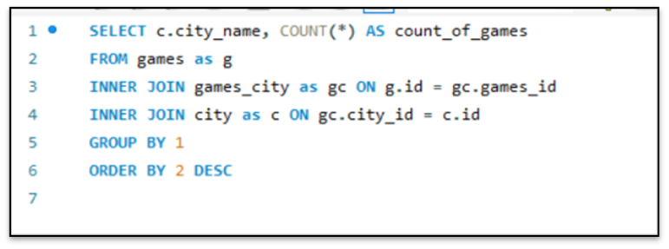

1
Calculate the frequency of cities for hosting Olympic Games?
London and Athina Hosted maximum
number of Olympic Games.

Slide 10
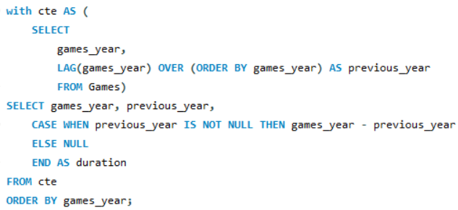
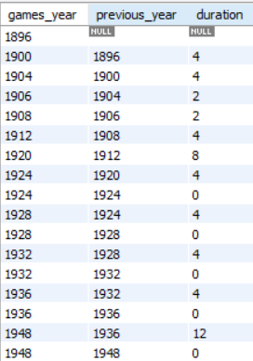
2
How has the duration of Olympic Games changed over time?
The maximum duration of 12 years is
found between 1936-1948

Slide 11
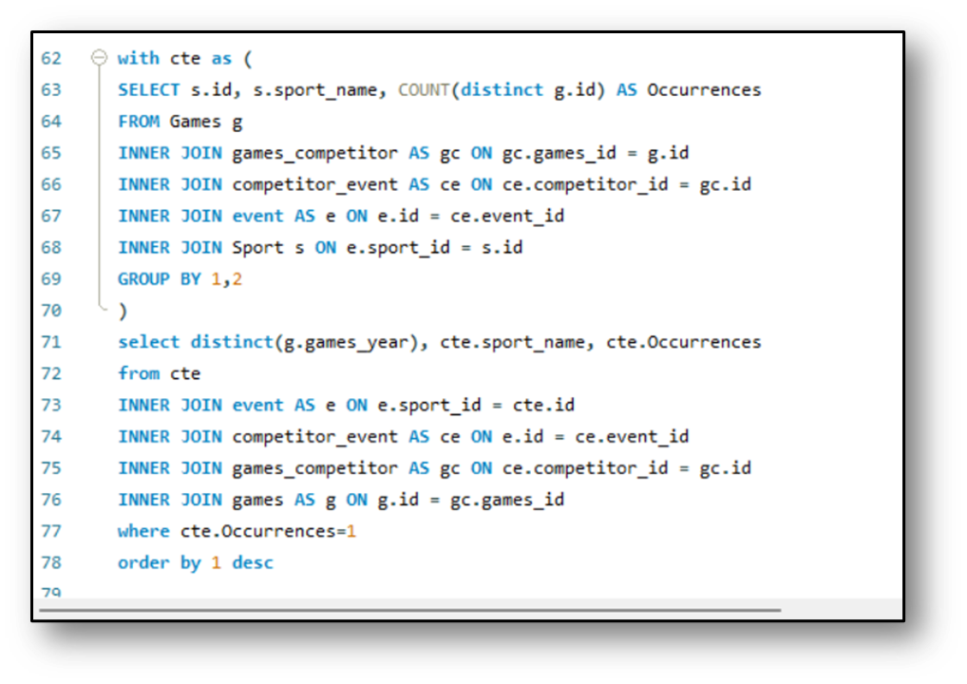
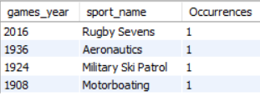
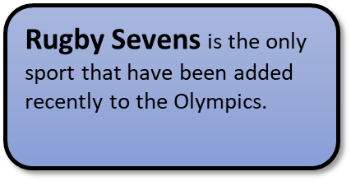
3
Are there any emerging sports that have been recently added to the Olympics?

Slide 12
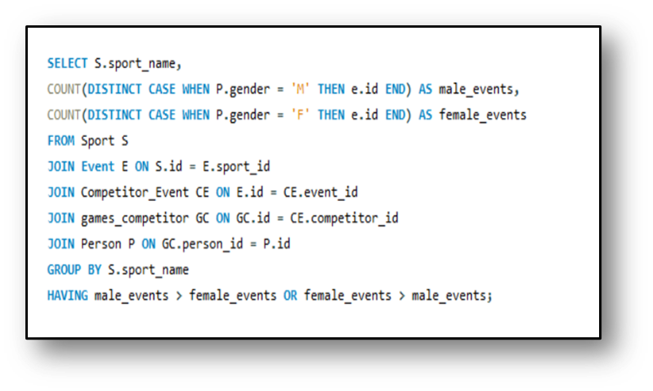
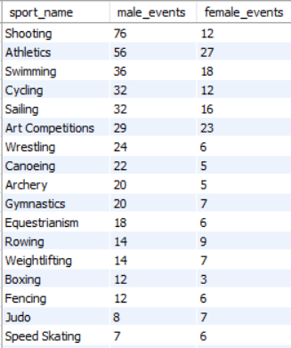
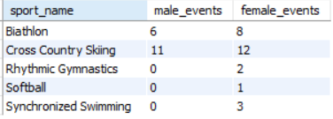
4
Are there any sports that have a higher number of events for one gender compared to others?
MALE > FEMALE
FEMALE > MALE
There are 39 Sports where Male events are more than Female events where as there are only 5 Sports where female events are more than male events.
Sports only played my males - Aeronautics, Baseball, Basque Pelota, Cricket, Jeu De Paume, Lacrosse, Military Ski Patrol, Nordic Combined, Polo, Racquets, Roque, Rugby and Tug-Of-War.
Sports only played my females - Rhythmic Gymnastics, Softball and Synchronized Swimming.

Slide 13
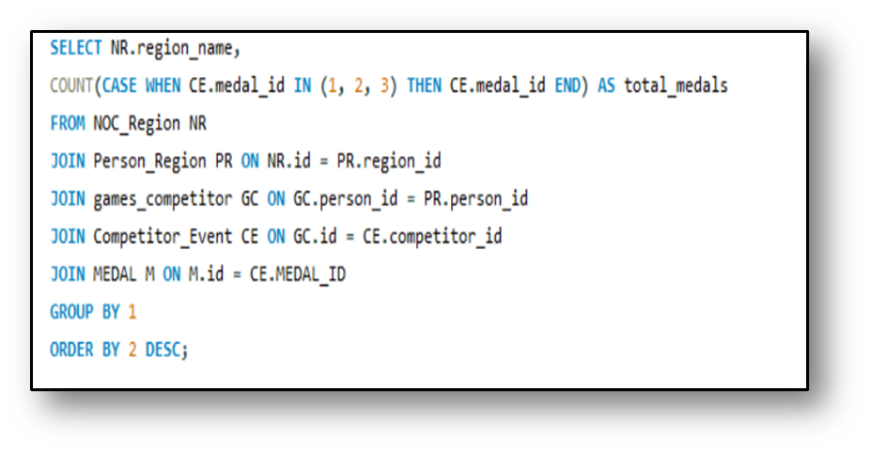
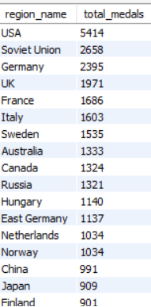
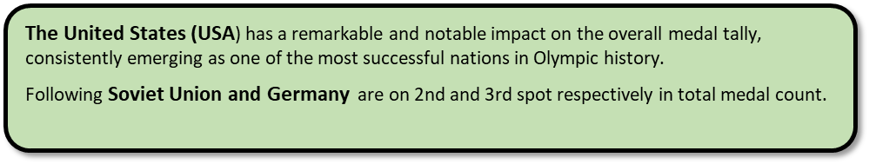
5
Find the regions that have had a notable impact on the overall medal tally?

Slide 14
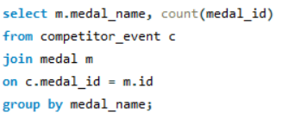
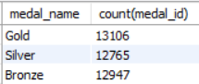
6
Calculate the medal counts as per
Gold, Silver and Bronze.
As per the insights,
there are maximum no. of Gold medals

Slide 15
POWER BI ANALYSIS

Slide 16
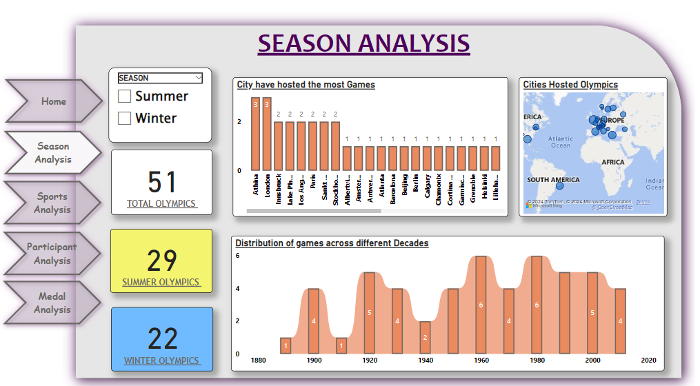
There have been a total of 51 Olympic Games held to date.
29 Summer Olympics.
22 Winter Olympics.
Cities Hosting the Most Games: Angeles, Paris, Sankt Moritz, and others, have hosted the Games twice.
Athens and London have each hosted the Olympics three times, the highest among all cities.
The map indicates a higher concentration of host cities in Europe and North America, with fewer games hosted in other continents.
The graph shows the number of Olympic Games held in different decades: Early 1900s saw a peak with four games.
The 1960s and 1980s each hosted six games.
The frequency of games varied over the decades, with noticeable dips during periods of major global events such as World Wars.

Slide 17
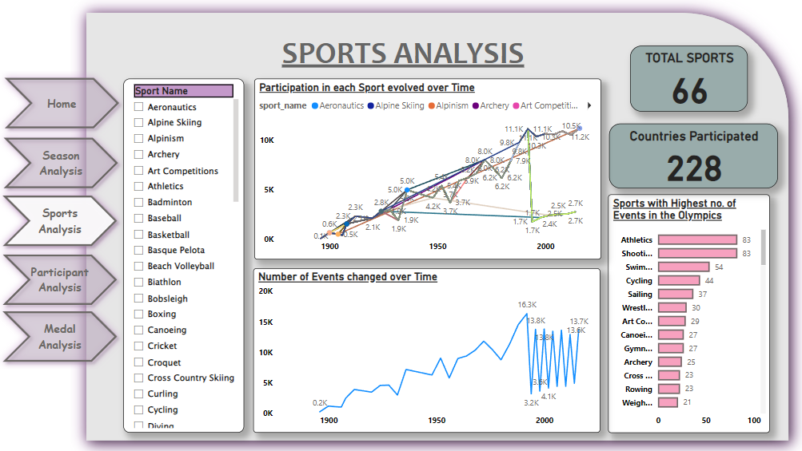
There are a total of 66 sports represented in the Olympics.
A total of 228 countries have participated in the Olympics.
Participation Trends in Various Sports:
Athletics and Shooting have the highest number of events, each with 83 events.
Other sports with a high number of events include: Swimming: 54 events, Cycling: 44 events
The graph shows a notable increase in participation over time for most sports, indicating growing interest and expansion.
The number of Olympic events has increased significantly from 0.2K in 1900 to peaks such as 16.3K in the late 20th century.
There have been fluctuations in the number of events, with some decreases, but the overall trend shows growth.
Historical sports like Art Competitions, which no longer exist in the modern Olympics, reflect the evolving nature of the Games. Understanding why certain sports were phased out can provide insights for future inclusions.

Slide 18
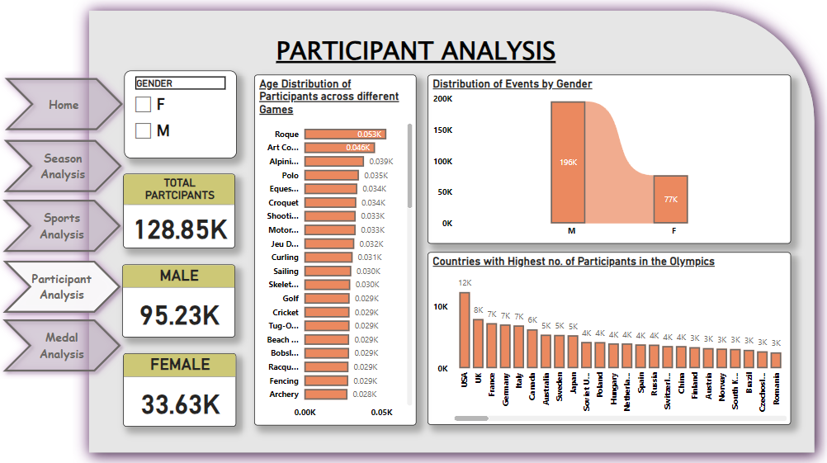
The total number of participants in the Olympics is approximately 128.85K.
Gender Distribution:
Male Participants: 95.23K
Female Participants: 33.63K
The distribution shows a significant gender gap, with male participants outnumbering female participants by a large margin.

Slide 19
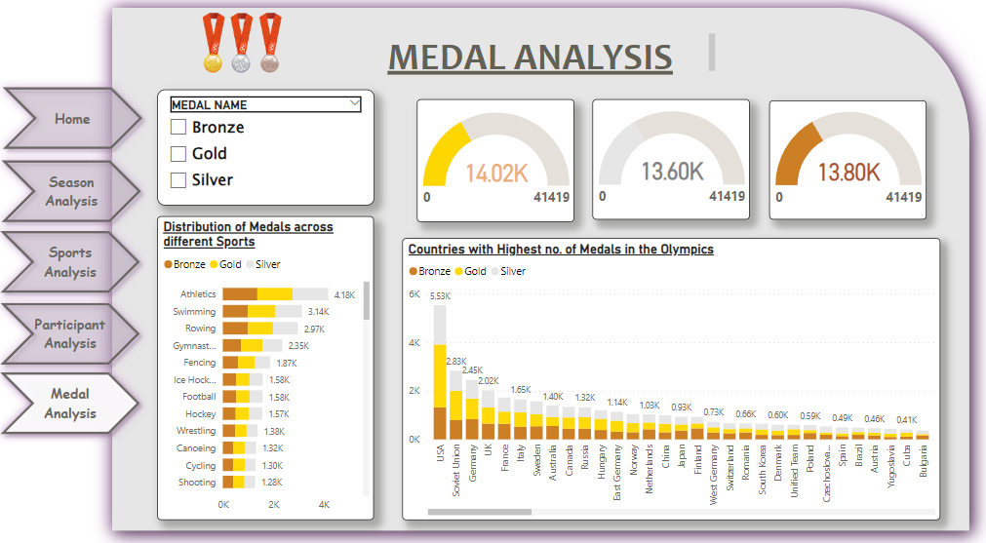

Slide 20
KEY INSIGHTS
USA is dominating in overall aspects such as medals, participants.
Male participants count is more than female participants.
The Olympic Games were suspended due to the outbreak of World War II from 1936-1948.
London hosted maximum Olympics.

Slide 21

DATA SOURCE
KAGGLE

Slide 22

THANK'S FOR WATCHING

